Slide 1
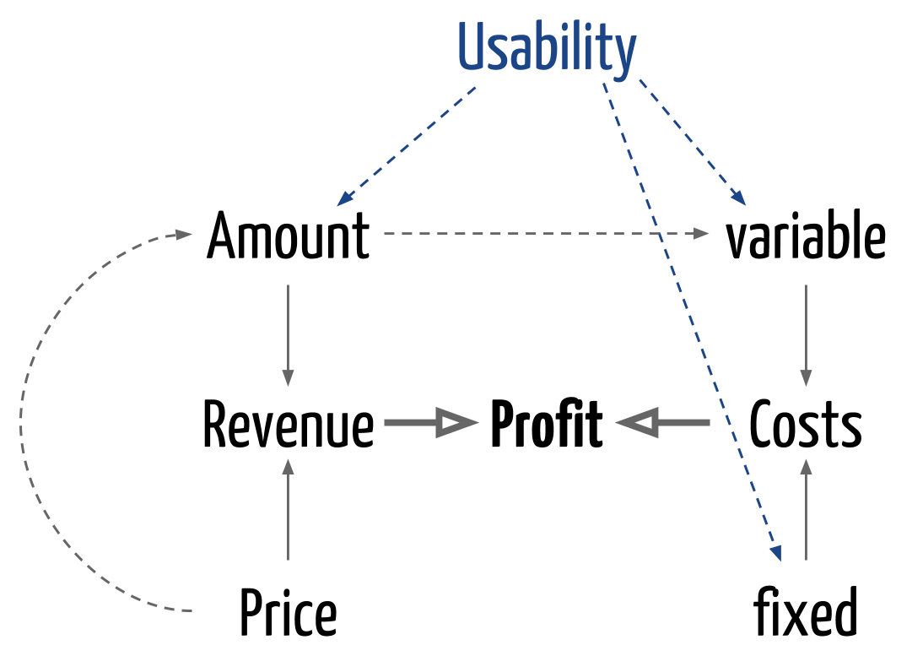
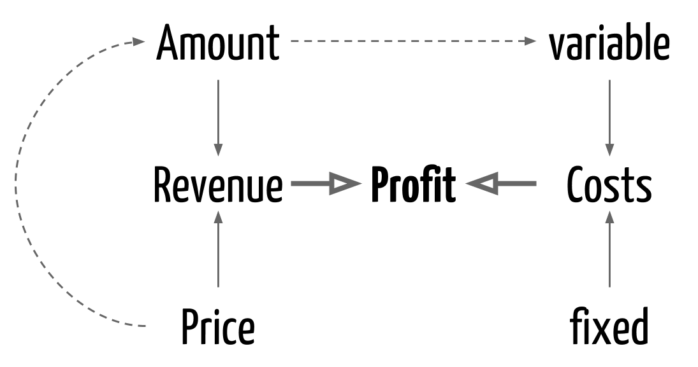
Usability, Revenue, Costs, & Profit

Slide 2
Why is usability important?
Poor usability results in
  anger and frustration
  decreased productivity in the workplace
  higher error rates
  physical and emotional injury
  equipment damage
  loss of customer loyalty
  costs money

Slide 3
What is usability?
Usability is a measure of the effectiveness, efficiency and satisfaction with which specified users can achieve specified goals in a particular environment.

Slide 4
The user interface
The user interface is the system that helps users communicate with the computer system and/or the application system.
User interfaces should be designed to match the skills, experience and expectations of its anticipated users.
System users often judge a system by its interface rather than its functionality.
A poorly designed interface can cause a user to make catastrophic errors.
Poor user interface design is the reason why so many software systems are never used.

Slide 5
Human factors in interface design
Limited short-term memory
  People can instantaneously remember about 7 items of information. If you present more than this, they are more liable to make mistakes.
People make mistakes
  When people make mistakes and systems go wrong, inappropriate alarms and messages can increase stress and hence the likelihood of more mistakes.
People are different
  People have a wide range of physical capabilities. Designers should not just design for their own capabilities.
People have different interaction preferences
  Some like pictures, some like text.

Slide 6
Basic Principles
Assume users
  Have not read the manual
  Have not attended training
  Do not have external help readily at hand
So…
All controls should be clear and understandable and placed in an intuitive location on the screen.

Slide 7
Basic Principles
UI design must take account of the needs, experience and capabilities of the system users.
Designers should be aware of people’s physical and mental limitations (e.g. limited short-term memory) and should recognise that people make mistakes.
UI design principles underlie interface designs although not all principles are applicable to all designs.

Slide 8
User interface Design principles
User familiarity
  The interface should be based on user-oriented terms and concepts rather than computer concepts. For example, an office system should use concepts such as letters, documents, folders etc. rather than directories, file identifiers, etc.
Consistency
  The system should display an appropriate level of consistency. Commands and menus should have the same format, command punctuation should be similar, etc.
Minimal surprise
  If a command operates in a known way, the user should be able to predict the operation of comparable commands

Slide 9
User interface Design principles
Recoverability
  The system should provide some resilience to user errors and allow the user to recover from errors. This might include an undo facility, confirmation of destructive actions, 'soft' deletes, etc.
User guidance
  Some user guidance such as help systems, on-line manuals, etc. should be supplied
User diversity
  Interaction facilities for different types of user should be supported. For example, some users have seeing difficulties and so larger text should be available

Slide 10
Design issues in UIs
Two problems must be addressed in interactive systems design
  How should information from the user be provided to the computer system?
  How should information from the computer system be presented to the user?

Slide 11
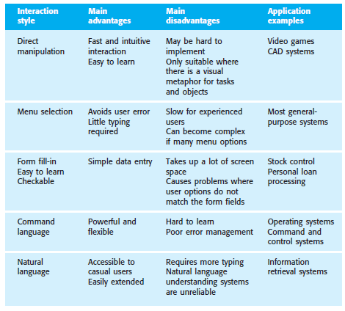
Interaction styles

Slide 12
Typical Web-site Usability Problems
Navigation
  Knowing where you are
  Finding what you want
Structure of web site
Layout
  Needs sufficient white space
  Use of large graphics

Slide 13
User Centered Design
UCD is a dialog between the customer and the designer
Rules of thumb:
  Get to know and understand the users.
  Build an application, applying usability principles.
  Test designs by observing users in a real work setting (environment and work load).

Slide 14
UI Design is Multi Disciplinary
A team includes
  Analyst
  Designer
  Technology expert
  Graphic artist
  Social and behavioral scientist
  Programmer

Slide 15
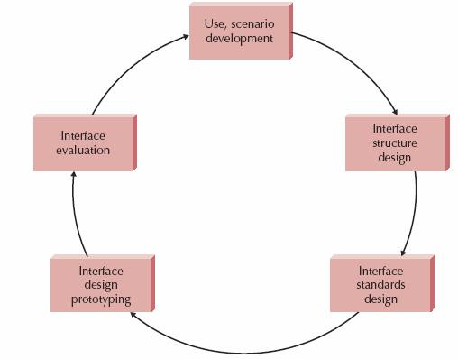
Usability Design Process
You already know about use cases
User scenarios are just a single thread through a use case – much simpler!
goal of user interface evaluations is to make products and services more usable, easy to learn and intuitive for the user.
This matters much less than it used to. Why?
What can you do about it?
The interface standards are the basic design elements that are common across the screens, forms, and reports within the system.
What do you think of this?
Storyboard
Low-fidelity prototypes are good!
Paper prototype
Visio/HTML/PPT/…

Slide 16
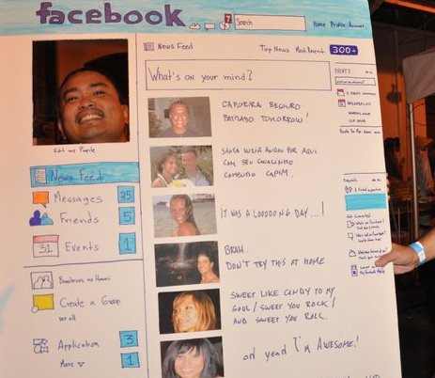
Example : Paper prototype
Notes:
1616

Slide 17
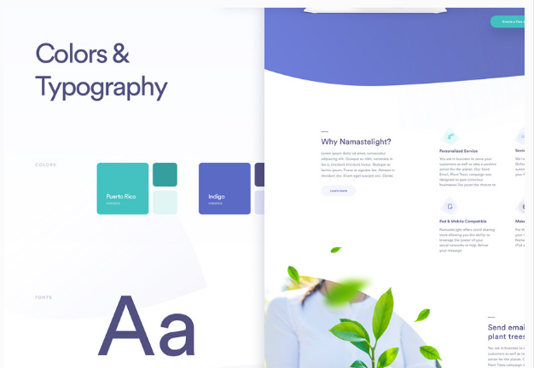
Golden Rules for Better Interface Design
1. Strive for Consistency
Designing “consistent interfaces” means using the same design patterns and the same sequences of actions for similar situations.
This includes, but isn’t limited to, the right use of color, typography and terminology in prompt screens, commands, and menus throughout your user journey.
a consistent interface will allow your users to complete their tasks and goals much more easily.

Slide 18
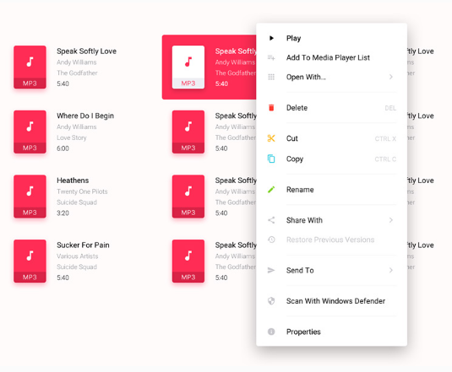
Golden Rules for Better Interface Design
2. Enable Frequent Users to Use Shortcuts
Users will benefit from shortcuts if they need to complete the same tasks often.
Expert users might find the following features helpful:
  Abbreviations
  Function keys
  Hidden commands
  Macro facilities

Slide 19
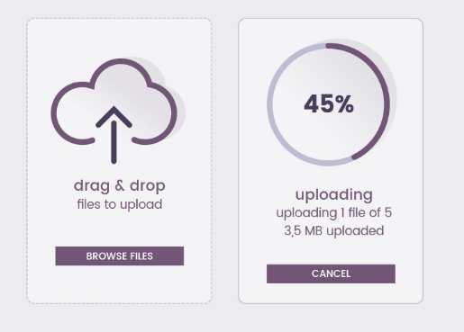
Golden Rules for Better Interface Design
3. Offer Informative Feedback
need to keep users informed of what is happening at every stage of their process.
This feedback needs to be meaningful, relevant, clear, and fit the context.

Slide 20
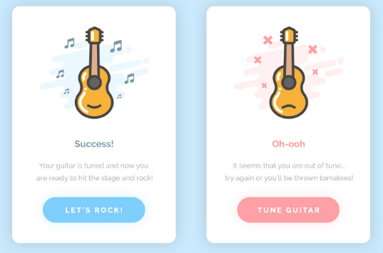
Golden Rules for Better Interface Design
4. Design Dialog to Yield Closure
Sequences of actions need to have a beginning, middle and end.
Once a task is completed, give some peace of mind to your user by providing them informative feedback and well-defined options for the next step if that’s the case.
Don’t keep them wondering!

Slide 21
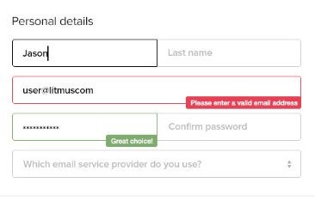
Golden Rules for Better Interface Design
5. Offer Simple Error Handling
A good interface should be designed to avoid errors as much as possible.
But when errors do happen, your system needs to make it easy for the user to understand the issue and know how to solve it.
Simple ways to handle errors include displaying clear error notifications along with descriptive hints to solve the problem.

Slide 22
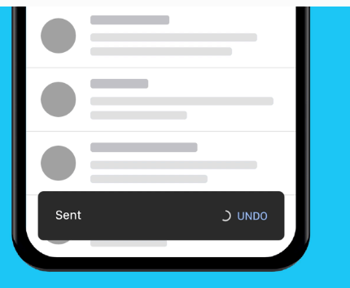
Golden Rules for Better Interface Design
6. Permit Easy Reversal of Actions
It’s an instant relief to find that “undo” option after a mistake is made.
Users will feel less anxious and more likely to explore options if they know there’s an easy way to reverse any accidents.
This rule can be applied to any action, group of actions, or data entry.

Slide 23
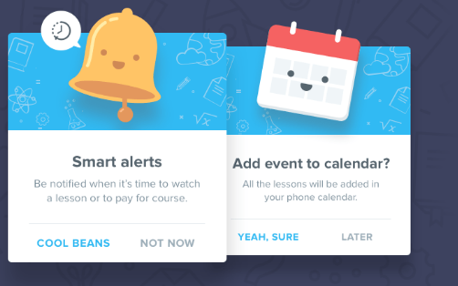
Golden Rules for Better Interface Design
7. Support Internal Locus of Control
It’s important to give control and freedom to your users so they’re able to feel they’re in charge of the system, not the other way round.
Avoid surprises, interruptions, or anything that hasn’t be prompted by the users.
Users should be the initiators of the actions rather than the responders.

Slide 24
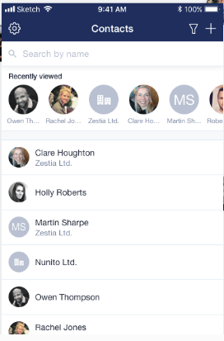
Golden Rules for Better Interface Design
8. Reduce Short-Term Memory Load
If we keep our interfaces simple and consistent, obeying to patterns, standards and conventions, we are already contributing to better recognition and ease of use.
There are several features we can add to aid our users depending on their goals. For example, in an ecommerce environment, a list of recently viewed or purchased items.

Slide 25
User interface evaluation
Some evaluation of a user interface design should be carried out to assess its suitability.
Full scale evaluation is very expensive and impractical for most systems.
Ideally, an interface should be evaluated against a usability specification. However, it is rare for such specifications to be produced.
Usability Criteria

Slide 26
Simple evaluation techniques
Less expensive techniques for user interface evaluation:
  Questionnaires
  Observations of users at work
  Video snapshots of typical uses
  Software components that gather information on the usage of the user interface
  Software components that allow direct feedback from users

